Slide 1
Python Course for Physicists (And everyone else!) Chunk 1: Introduction & Setup
By Jonathan Bollig
08.10.2025

Slide 2

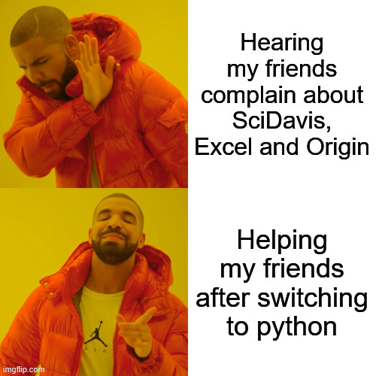
Background & About Me
jonathan.bollig@uni-jena.de
Master: Physics & Photonics
Bachelor: Physics in Jena
Self-taught Python with YouTube before studying
Super useful in physics
Tried to convince all my friends
Now a course for everyone else
→ First time, let’s see how it goes ☺
Notes:
Go with the flow
Vielleicht erwähnen, dass ich nicht bezahlt werde?

Slide 3


The Tutors
Erik Prenzel (erik.prenzel@uni-jena.de)
Student in Physics Master
Friend of Jonathan
Learned Python during my studies, 100% worth it
Hinrich Dirksen (hinrich.dirksen@uni-jena.de)
Currently pursuing my experimental physics master thesis
I use Python everyday from data analysis+vis. to small simulations and automations in the lab
3x better code since GitHub copilot arrived

Slide 4


The Tutors
Philipp Janzen (philipp.janzen@uni-jena.de)
Physics Master‘s student
Friend of Jonathan
Learned Python during my studies
Verena Menhofer (verena.menhofer@uni-jena.de)
Physics Master‘s student
Another friend of Jonathan
Started learning Python with YouTube, but mostly learnt as needed during studies

Slide 5
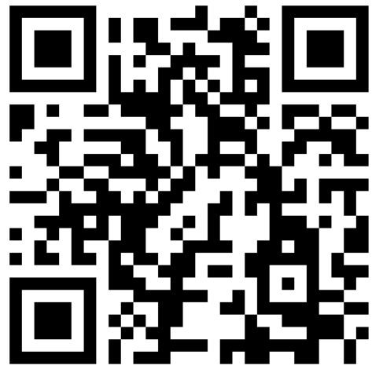
About You: (Experimental) Questionare
https://vibes.fh-muenster.de/apps/live-votings/XETR2/
Notes:
Only in German, but we will manage

Slide 6
General Information – Times and Dates
Dates:
Regular: Wednesday to Friday
Maybe Saturday if delayed or for extra “chunks” (Improvised if demanded)
Times:
Start at 09:30
Lunchbreak 12:30 – 13:30
Finish: ~16:30
Lecturing type:
15-minute lectures (Chunks) with 45-minute practice sessions
3 chunks before and 3 after lunch → 18 chunks in total
Exception: Now

Slide 7
General Information – Lecturing Type
15 Minute Lectures: Concise introductions to topics
YouTube tutorial style
PDFs are uploaded
45 Minute self practice:
Usage of Jupyter Notebooks: Tasks and solutions in one place.
Easy, medium and advanced tasks
Generally:
Come and Go whenever you like
Ask Questions directly (Maybe everyone is wondering the same)
ALL Slides etc. are shared ☺
Notes:
Mention YouTube Style

Slide 8

Why Coding?
Data Analysis
Visualization
Simulations
Automation
Machine Learning
…

Slide 9
Own Examples
Automated Experiment (UV-Experiment)
Data Analysis from Lab (Oszi data from Experimental Optics)
Irgendeine Simulation (vielleicht von PCQM)

Slide 10
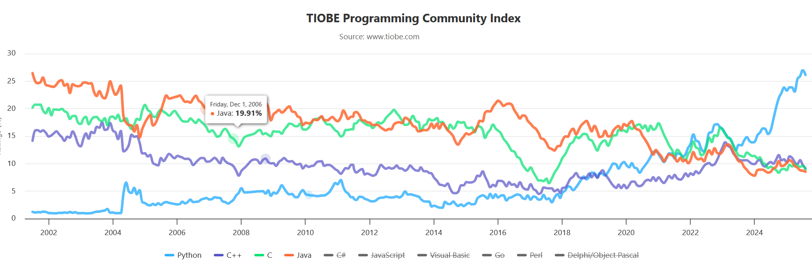
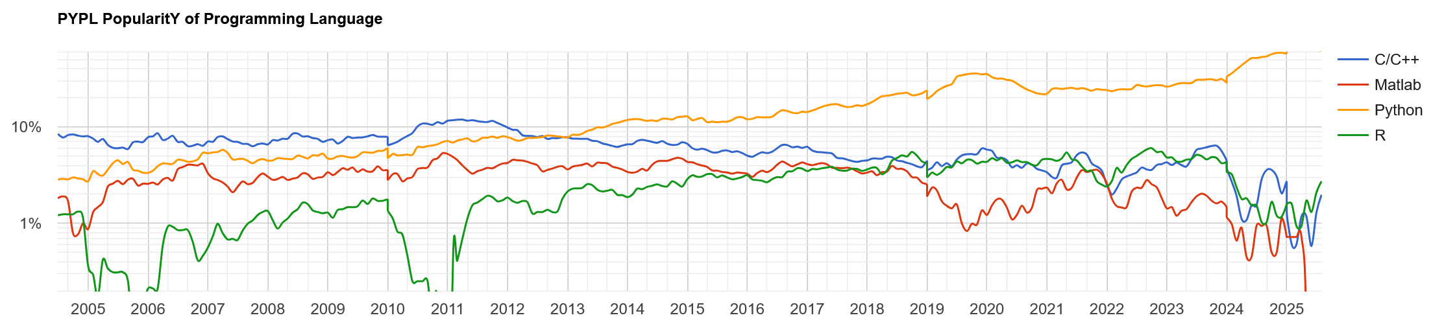
Why Python?
Most popular programming language world-wide
Web Development, AI / LLM, Data Science
Popular in the scientific community (anecdotal evidence)
Open Source / Free
Easy to learn
[https://pypl.github.io/PYPL.html]
[https://www.tiobe.com/tiobe-index/]
Notes:
Tiobe Index: Complicated calculation
Pypl Index: Popularity based on web searches (Here Data for Germany)
Anecdote on Python helping me in applications

Slide 11
Comparison to other languages, (dis)advantages of Python
Easy to learn
Readable
Slow but can be fast
Popular

Slide 12
Learning goals
Ability to use python as a tool in everyday (physics) life
Read and write data
Process and clean data
Visualize data
We won’t cover
Game Design
Webdesign
What I might cover in the future:
Recursion
Version Control w. Git
Pretty Coding / PEP / Typing
Object Oriented Programming
Multithreading / Processing

Slide 13
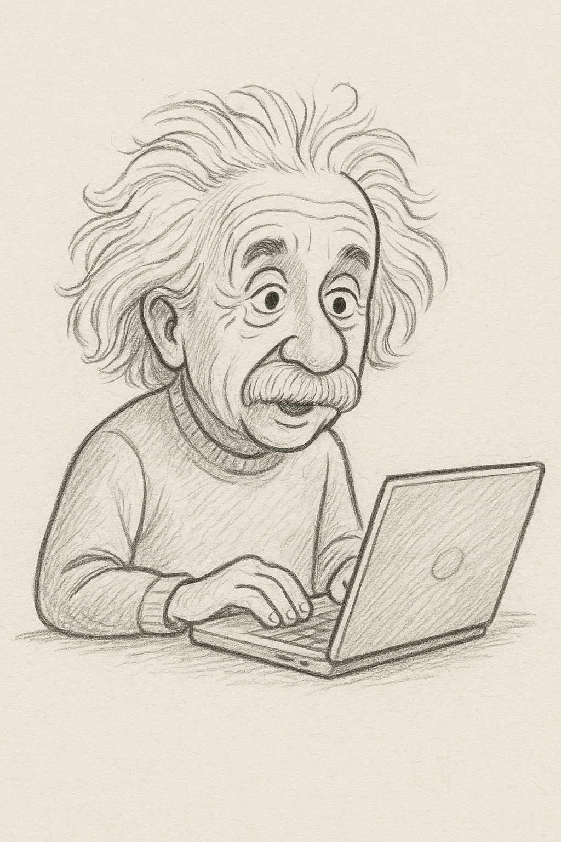
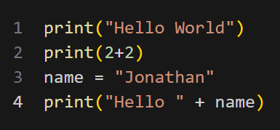
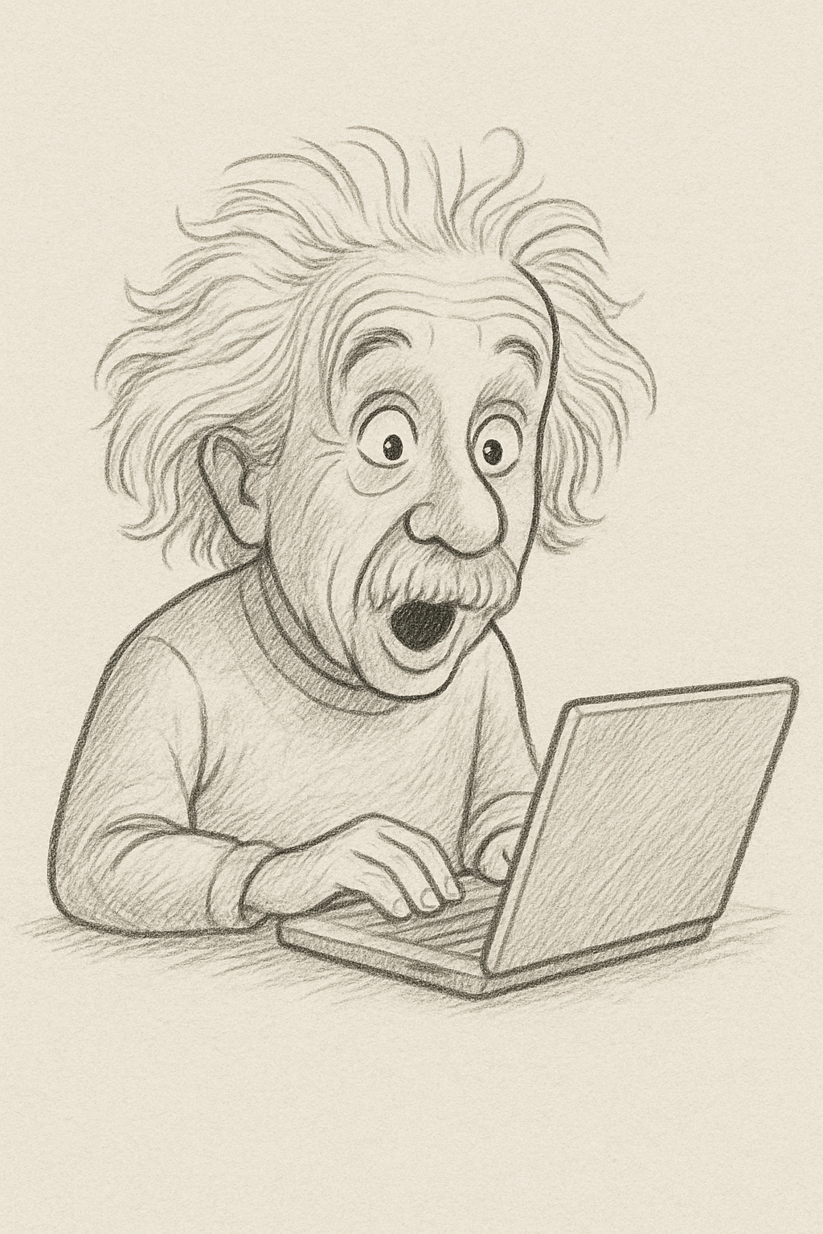
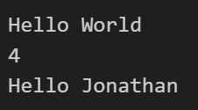
What is a program?
Some Magic 🪄
(Beyond our scope, google if interested)
[ChatGPT ☺]
[ChatGPT ☺]

Slide 14
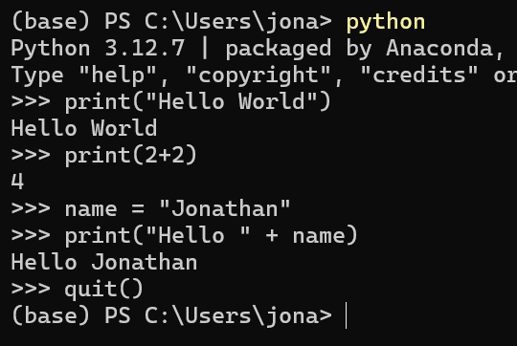
2,5 Ways of Coding in Python
Skript:
Starts Python
Runs Code from first to last line
Finishes (closes Python) when last line is executed
After execution: Memory lost
Interactive:
Python is started
Executes commands “on the go”
Python is manually closed
→ Memory maintained

Slide 15
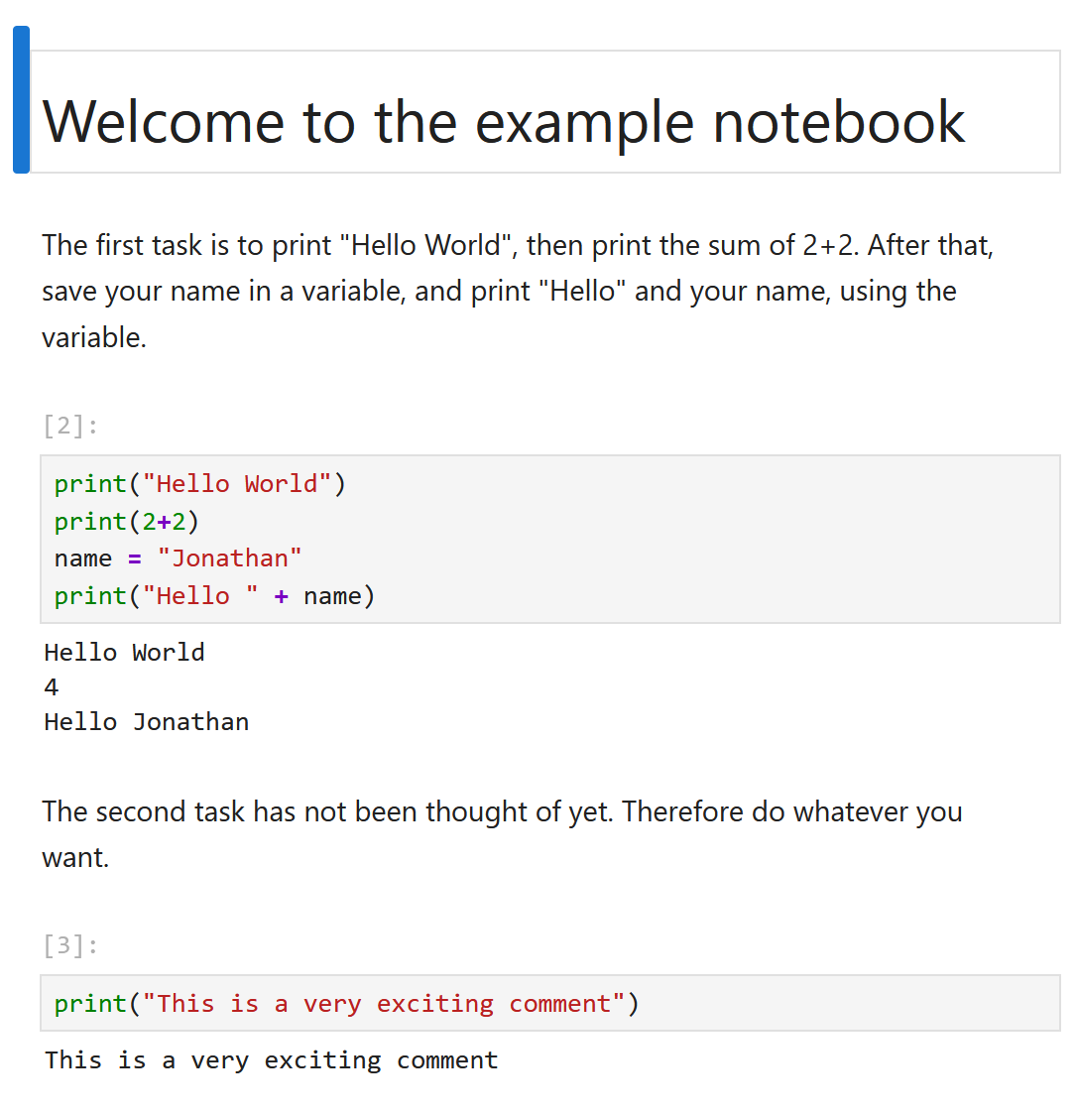
2,5 Ways of Coding in Python: Notebooks
Jupyter Notebooks are interactive, but group code in cells:
Advantages:
Tasks, Cheat Sheets and place for solving all in one place.
No extra IDE needed.
Disadvantages:
Sometimes stuff works, that shouldn’t
Can promote bad coding practises
In this course: Python + Notebooks treaded as one. At end of course: Introduction to other IDEs

Slide 16
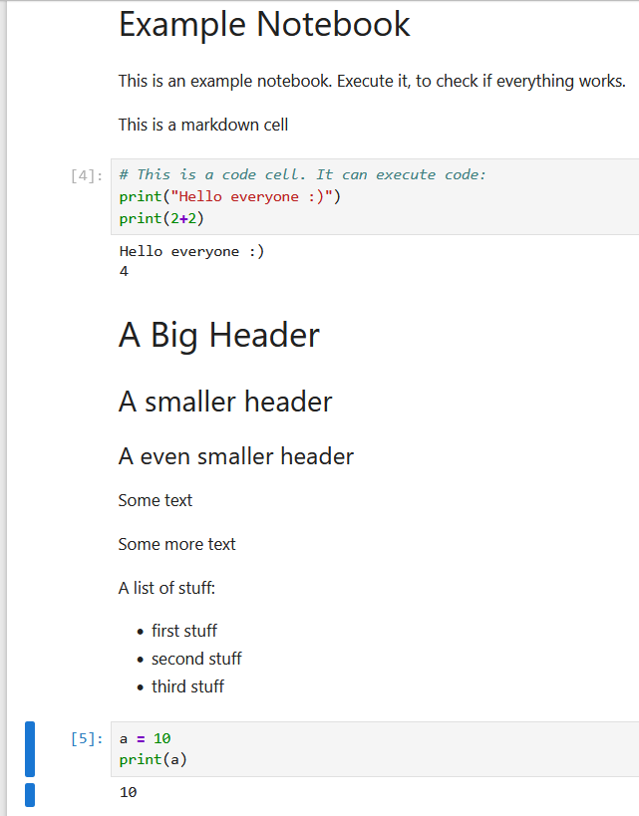
Notebook Live Demo: Cells
Markdown Cells
Code Cells
Cells can be:
Moved
Copy Pasted
Etc.

Slide 17
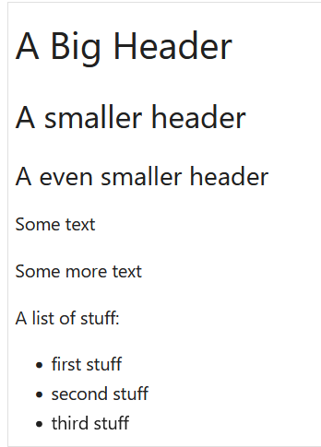
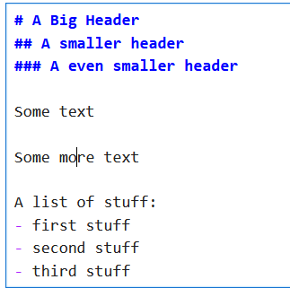

Notebook Live Demo: Markdown Cells
Execute Cell: Shift + Enter or

Slide 18

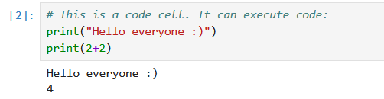
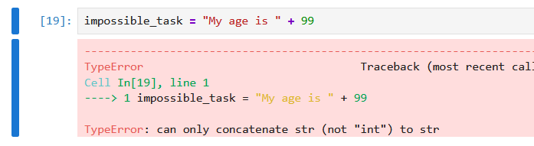
Notebook Live Demo: Code Cells
Number indicates execution
Errors appear in Red
Pay attention to last line
Execute Cell: Shift + Enter or

Slide 19

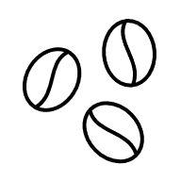
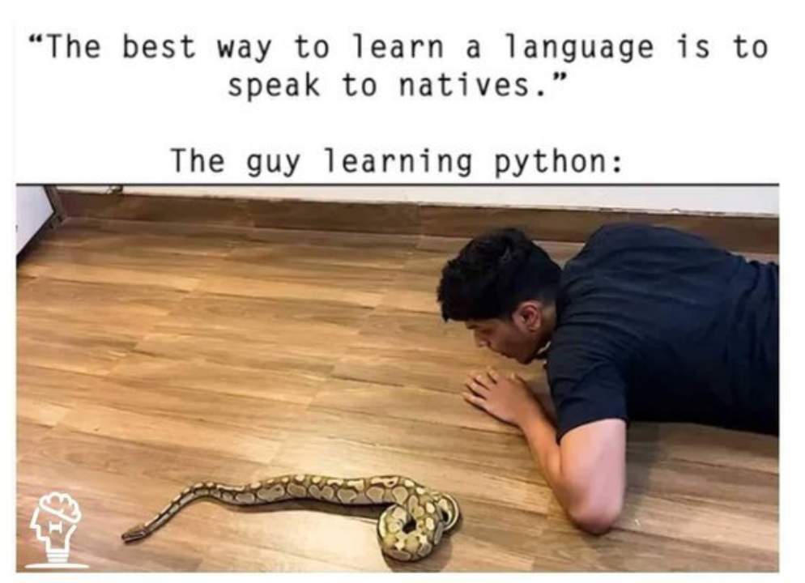
Now you:
Try to open the file “Tasks_1_2_example_notebook.ipynb” and execute the cells
In case of problems: Ask us
Time: 30 Minutes (inkl. Coffee Break)
[https://dev.to/codeitbro/15-funniest-and-hilarious-python-coding-memes-2aij]

